Slide 1
SQL
Lecture 6

Slide 2
Contents
Joins
Inner Join
Left Join
Right Join
Full Join
Self Join
Union

Slide 3
departments
students
id | name | phone
1 | CSE | 899876
2 | Bangla | 775465
3 | English | 674565
4 | AIS | 9787686
id | name | roll | dept_id
1 | Alice | 121 | 1
2 | Brown | 122 | 1
3 | Charlie | 123 | 2
4 | Davis | 124 | 3
5 | Elis | 125 | 2
6 | Frank | 126 | 2
Student_info
student_name | student_roll | dept_name

Slide 4
courses
instructors
id | title | course_code | level | credits | instructor_id
1 | Introduction to Computer Sci | CSE101 | Undergraduate | 3.o | 1
2 | Data Structure | CSE201 | Undergraduate | 3.5 | 2
3 | Database Systems | CSE301 | Undergraduate | 3.0 | 3
id | name | email | designation | phone | salary
1 | Md. Rahim | rahim@univ.edu.bf | Professor | 01710000001 | 90000.00
2 | Ayesha Begum | ayesha@univ.edu.bd | Asst. Professor | 01710000002 | 70000.00
3 | Tanvir Hossain | tanvir@univ.edu.bd | Lecturer | 01710000003 | 50000.00

Slide 5
learners
enrollments
id | name | roll | email | date_of_birth | city
1 | Hasibul Alam | 20181001 | arif@univ.edu.bd | 1998-07-15 | Dhaka
2 | Shirin Akter | 20181002 | shirin@univ.edu.bd | 1999-04-12 | Chittagong
3 | Arif Hossain | 20181003 | arif@univ.edu.bd | 2000-01-25 | Rajshahi
id | student_id | course_id | enrollment_date | status
1 | 1 | 1 | 2023-01-15 | Enrolled
2 | 2 | 2 | 2023-01-16 | Enrolled
3 | 3 | 3 | 2023-01-17 | Enrolled

Slide 6
assessments
results
id | course_id | assessment_title | total_marks
1 | 1 | Midterm Exam | 100
2 | 2 | Final Exam | 100
3 | 3 | Project Evaluation | 50
id | student_id | assessment_id | marks_obtained
1 | 1 | 1 | 85
2 | 2 | 2 | 90
3 | 3 | 3 | 40

Slide 7
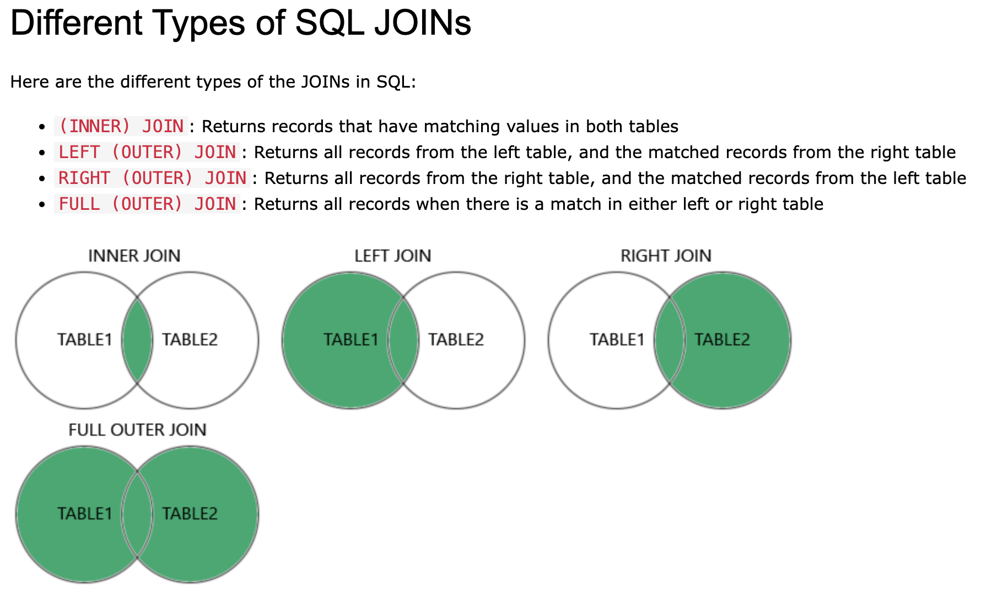
Joins
A JOIN clause is used to combine rows from two or more tables, based on a related column between them.

Slide 8
Inner Join
The INNER JOIN keyword selects records that have matching values in both tables.
Syntax:
SELECT column_name(s)
FROM table1
INNER JOIN table2
ON table1.column_name = table2.column_name;
Example: Between Learners and Enrollments table
SELECT courses.title, courses.course_code,instructors.name,
FROM courses INNER JOIN instructors
ON instrctors.id = courses.instructors_id;

Slide 9
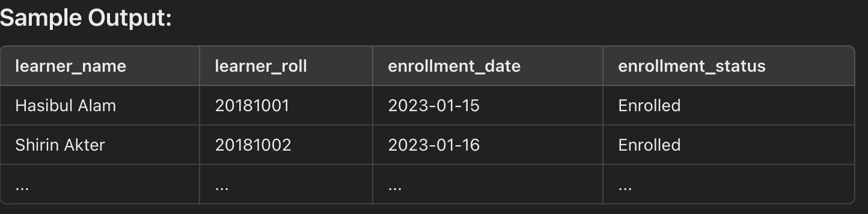
Inner Join
Example: Between Learners and Enrollments table
SELECT
learners.name AS learner_name,
learners.roll AS learner_roll,
enrollments.enrollment_date AS enrollment_date,
enrollments.status AS enrollment_status
FROM
learners
INNER JOIN enrollments ON learners.id = enrollments.student_id
ORDER BY learners.name;
Sample Output:

Slide 10
Left Join
The LEFT JOIN keyword returns all records from the left table (table1), and the matching records from the right table (table2).
The result is 0 records from the right side, if there is no match.
Syntax:
SELECT column_name(s)
FROM table1
LEFT JOIN table2
ON table1.column_name = table2.column_name;
Example:
SELECT
courses.title AS course_title,
courses.course_code AS course_code,
enrollments.enrollment_date AS enrollment_date,
enrollments.status AS enrollment_status
FROM Courses
LEFT JOIN enrollments ON courses.id = enrollments.course_id
ORDER BY courses.title;

Slide 11
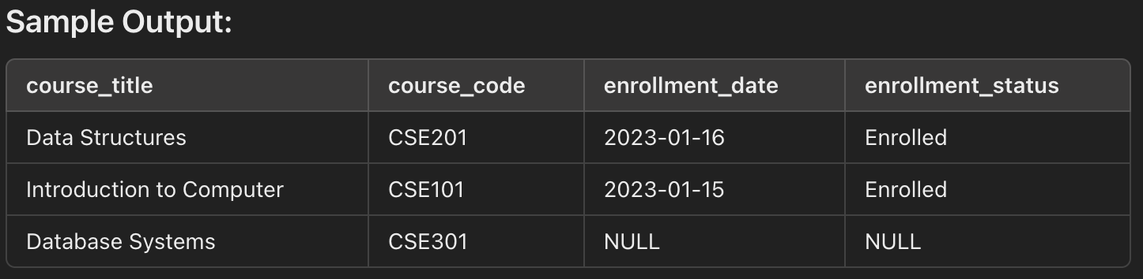
Left Join
Example: Between Courses and Enrollments
SELECT
courses.title AS course_title,
courses.course_code AS course_code,
enrollments.enrollment_date AS enrollment_date,
enrollments.status AS enrollment_status
FROM Courses
LEFT JOIN enrollments ON courses.id = enrollments.course_id
ORDER BY courses.title;

Slide 12
Right Join
The LEFT JOIN keyword returns all records from the right table (table2), and the matching records from the left table (table2).
The result is 0 records from the right side, if there is no match.
Syntax:
SELECT column_name(s)
FROM table1
RIGHT JOIN table2
ON table1.column_name = table2.column_name;
Example: Between Learners and Enrollments table
SELECT
learners.name AS learner_name,
learners.roll AS learner_roll,
enrollments.enrollment_date AS enrollment_date,
enrollments.status AS enrollment_status
FROM learners
RIGHT JOIN enrollments ON learners.id = enrollments.student_id
ORDER BY enrollments.enrollment_date;

Slide 13
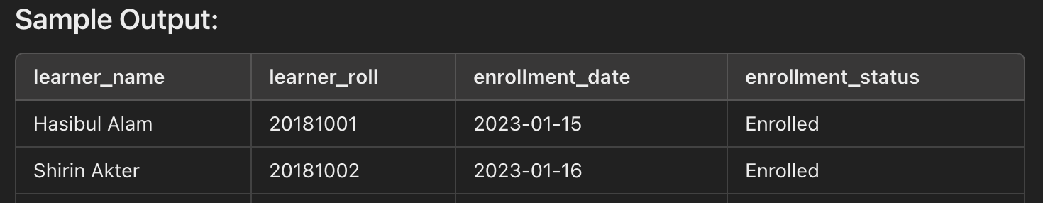
Right Join
Example: Between Learners and Enrollments table
SELECT
learners.name AS learner_name,
learners.roll AS learner_roll,
enrollments.enrollment_date AS enrollment_date,
enrollments.status AS enrollment_status
FROM learners
RIGHT JOIN enrollments ON learners.id = enrollments.student_id
ORDER BY enrollments.enrollment_date;

Slide 14
Exercise
Retrieve a list of all learners along with the courses they are enrolled in. Include the learner's name, course title, enrollment date, and enrollment status.
List all instructors along with the courses they teach. Include the instructor's name, course title, and course code. Ensure that instructors who are not teaching any courses are also included in the result.
List all courses along with their assigned instructors. Include the course title, course code, and instructor's name. Ensure that courses without an assigned instructor are also included in the result.

Slide 15
SOLUTION
SELECT learners.name AS Learner_Name,
courses.title AS Course_Title,
enrollments.enrollment_date,
enrollments.status
FROM enrollments
INNER JOIN
learners ON enrollments.student_id = learners.id
INNER JOIN
courses ON enrollments.course_id = courses.id;
2. SELECT instructors.name AS Instructor_Name,
courses.title AS Course_Title,
courses.course_code
FROM instructors
LEFT JOIN
courses ON instructors.id = courses.instructor_id
ORDER BY instructors.name;

Slide 16
SOLUTION
3. SELECT courses.title AS Course_Title,
courses.course_code,
instructors.name AS Instructor_Name
FROM courses
RIGHT JOIN
instructors ON courses.instructor_id = instructors.id
ORDER BY courses.title;

Slide 17
Exercises
Retrieve the list of learners along with the courses they are enrolled in.
List all learners, even if they haven’t enrolled in any course. If they haven’t enrolled, show NULL for the course title. (Left JOIN)
Find the total marks obtained by each learner. (Join, Group by)
List the learners enrolled in courses that are taught by instructors with a salary higher than 50,000 (join, where).
Find the names of learners who are enrolled in the course "Database Systems". (join, where)
Write a query to list the names of instructors and the titles of the courses they teach. (join)
Write a query to find the names of learners who obtained more than 60 marks in any course.

